Slide 2
TIMER
The PIC16F887 microcontroller has three completely separate timers/counters marked as:
TMR0
TMR1
TMR2

Slide 3
TIMER0
The timer TMR0 has a wide range of application in practice. Very few programs don’t use it in some way. It is very convenient and easy to use for writing programs or subroutines for generating pulses of arbitrary duration, time measurement or counting external pulses (events) with almost no limitations.

Slide 4
TIMER0
TMR0 module is an 8-bit timer/counter with the following features:
8-bit timer/counter
8 level prescaler (shared with Watchdog timer)
Programmable internal or external clock source
Interrupt on overflow
Programmable external clock edge selection.

Slide 5
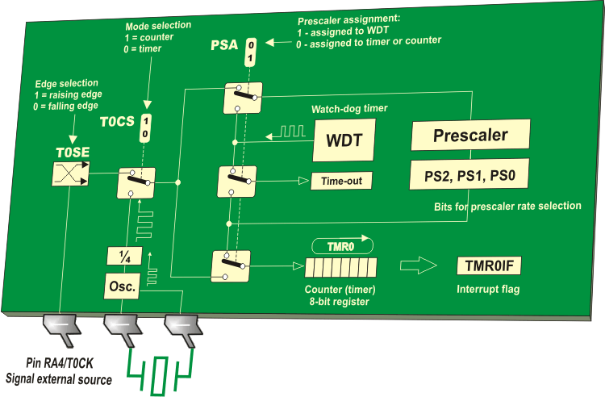
TIMER0

Slide 6
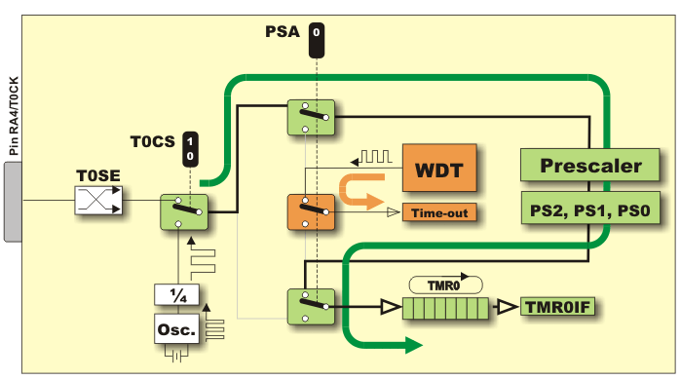

Slide 7
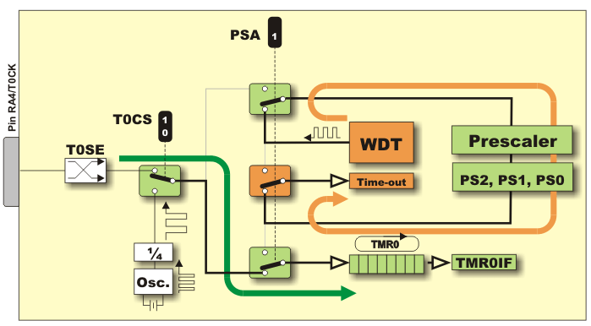

Slide 8
TIMER0 PRESCALER
PS2 | PS1 | PS0 | TMR0 | WDT
0 | 0 | 0 | 1:2 | 1:1
0 | 0 | 1 | 1:4 | 1:2
0 | 1 | 0 | 1:8 | 1:4
0 | 1 | 1 | 1:16 | 1:8
1 | 0 | 0 | 1:32 | 1:16
1 | 0 | 1 | 1:64 | 1:32
1 | 1 | 0 | 1:128 | 1:64
1 | 1 | 1 | 1:256 | 1:128

Slide 9
TO SELECT MODE
Timer mode is selected by the T0CS bit of the OPTION_REG register, (T0CS: 0=timer, 1=counter).
When used, the prescaler should be assigned to the timer/counter by clearing the PSA bit of the OPTION_REG register. The prescaler rate is set by using the PS2-PS0 bits of the same register.
When using interrupt, the GIE and TMR0IE bits of the INTCON register should be set.

Slide 10
TO MEASURE TIME
Reset the TMR0 register or write some known value to it.
Elapsed time is measured by reading the TMR0 register.
The flag bit TMR0IF of the INTCON register is automatically set every time the TMR0 register overflows. If enabled, an interrupt occurs.

Slide 11
TO COUNT PULSES
The polarity of pulses are to be counted on the RA4 pin is selected by the TOSE bit of the OPTION_REG register (T0SE: 0=positive, 1=negative pulses).
Number of pulses may be read from the TMR0 register.
The prescaler and interrupt are used in the same manner as in timer mode.

Slide 12
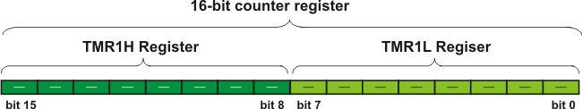
TIMER1
Timer TMR1 module is a 16-bit timer/counter, which means that it consists of two registers (TMR1L and TMR1H).
TMR1 can count up 65.535 pulses in a single cycle before the counting starts from zero.

Slide 13
TIMER1 FEATURES
16-bit timer/counter register pair
Programmable internal or external clock source
3 level prescaler
Optional LP oscillator
Synchronous or asynchronous operation
Timer TMR1 gate control (count enable) via comparator or T1G pin
Interrupt on overflow
Wake-up on overflow (external clock)
Time base for Capture/Compare function.

Slide 14
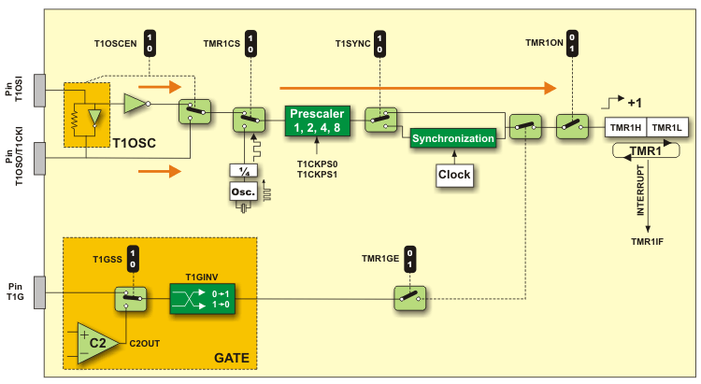
TIMER1 FEATURES

Slide 15
CLOCK SOURCE SELECTION
CLOCK SOURCE | TMR1CS
Fosc/4 | 0
T1CKI pin | 1
When the internal clock source is selected, the TMR1H-TMR1L register pair will be incremented on multiples of Fosc pulses as determined by the prescaler.
When the external clock source is selected, this timer may operate as a timer or a counter. Clock in counter mode can be synchronized with the microcontroller internal clock or run asynchronously. In the event that an external clock oscillator is needed and the PIC16F887 microcontroller is using INTOSC with CLKOUT, timer TMR1 can use the LP oscillator as a clock source.

Slide 16
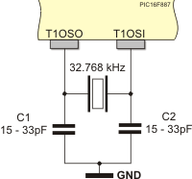
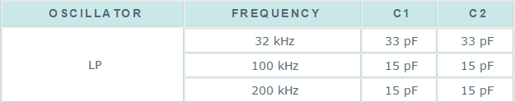
TIMER TMR1 OSCILLATOR

Slide 17
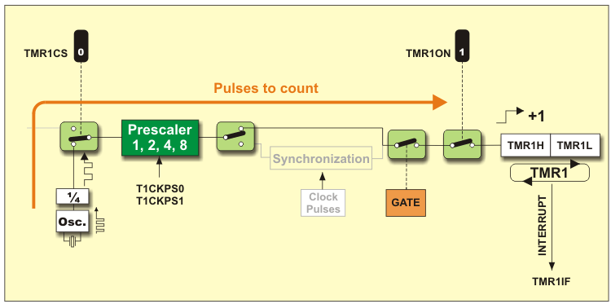
TIMER MODE

Slide 18
TIMER MODE
In this mode, the T1SYNC bit does not affect the timer because it counts internal clock pulses. Since the whole electronics uses these pulses, there is no need for synchronization.
The microcontroller’s clock oscillator does not operate during sleep mode so the timer register overflow cannot cause any interrupt.

Slide 19
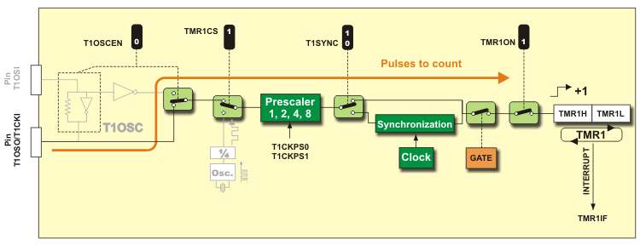
COUNTER MODE

Slide 20
COUNTER MODE
Timer TMR1 starts to operate as a counter by setting the TMR1CS bit. It counts pulses brought to the PC0/T1CKI pin and is incremented on the rising edge of the external clock input T1CKI.
If the control bit T1SYNC of the T1CON register is cleared, the timer TMR1 is synchronized to the microcontroller system clock and is called a synchronous counter.

Slide 21
TIMER 2
Timer TMR2 module is an 8-bit timer which operates in a very specific way
Pulses from the quartz oscillator first pass through the prescaler. The output of the prescaler is then used to increment the TMR2 register starting from 00h.
The values of TMR2 and PR2 are constantly compared and the TMR2 register keeps on being incremented until it matches the value in PR2.

Slide 22
TIMER 2
When the match occurs, the TMR2 register is automatically cleared to 00h. The timer TMR2 postscaler is incremented and its output is used to generate an interrupt if it is enabled.
The TMR2 and PR2 registers are both fully readable and writable.
Counting may be stopped by clearing the TMR2ON bit, which results in power saving.
The moment of TMR2 reset may also be used to determine the baud rate of synchronous serial communication.

Slide 23
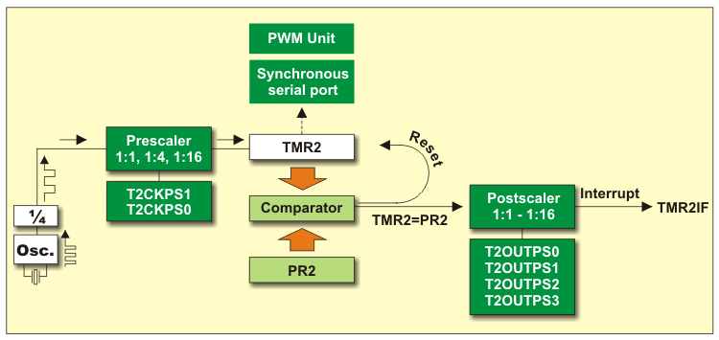

Slide 24
TIMER MAIN COMMANDS
setup_timer_X( mode )
X: 0-2
Mode:
- Timer or counter mode or disable timer
Prescaler
Constants from different groups may be or'ed together with |.
Ex: setup_timer_1 (T1_INTERNAL| T1_DIV_BY_8);
Setup timer 1 as timer mode and use prescaler 8
* Open file 16f887.h and find timer used to see options you can use with this command

Slide 25
TIMER MAIN COMMANDS
SET_TIMERX( value)
Sets the count value
X: 0-2
Value:
Timers 1 get a 16 bit int.
Timer 0 and 2 gets an 8 bit int.

Slide 26
TIMER MAIN COMMANDS
value=get_timerX();
Gets the count value
X: 0-2
Value:
If use timer 1: value is a 16 bit variable
If use timer 0 or 2 : value is an 8 bit variable

Slide 27
EXAMPLE
Count externals pulse and display the counted value on the second line of LCD using timer 0

Slide 28
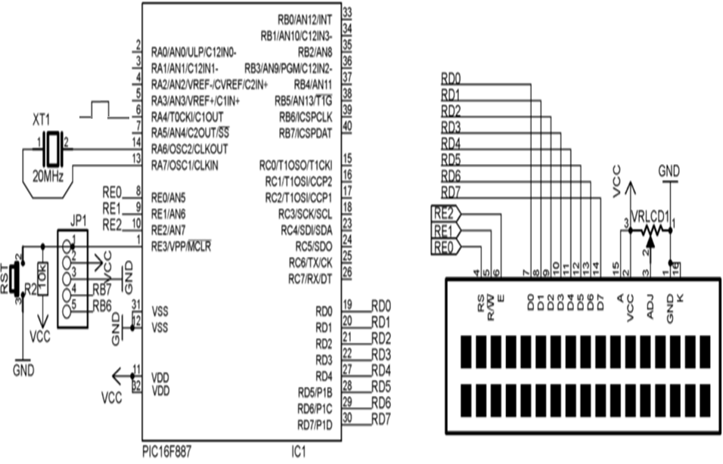
SCHEMATIC

Slide 29
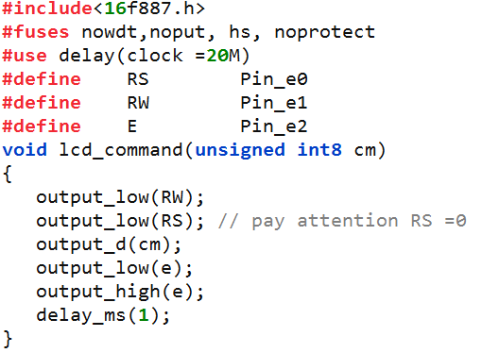
CODE

Slide 30
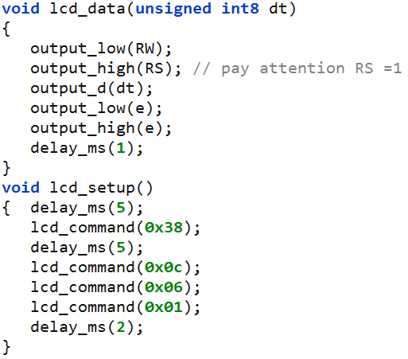
CODE

Slide 31
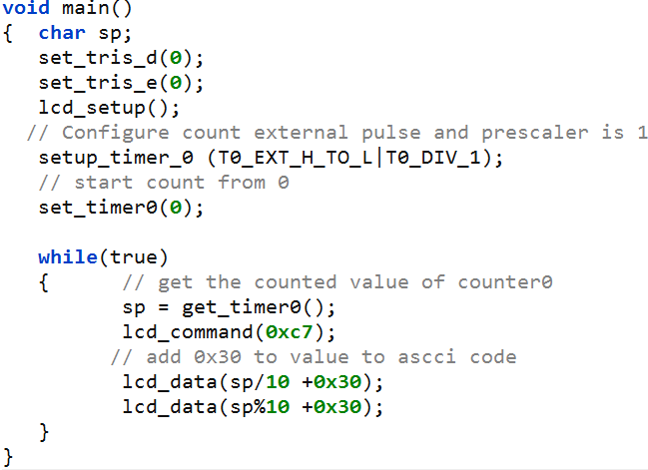
CODE

Slide 32
EXAMPLE
Measure one second using timer 1 and display the result of counting second from 0 to 59 on the second line of LCD

Slide 33
ANALYZE
Consider that crystal used is 20Mhz
After divided 4 the clock is 5Mhz => It mean that counter must count 5M pulses to be one second
The counter is limited to 65535 so we must use prescaler => Choose prescaler 8 => counter now must count 625k pulses to be one second=> Count ten times each 62500 pulses=> need to set counter to count from 65536 – 62500 = 3036
8
5M
625K
20M

Slide 34

SCHEMATIC
Control LCD display string “Test LCD 16x2” on line 2

Slide 35
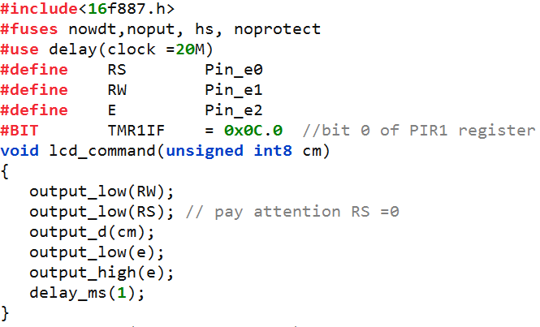
CODE

Slide 36
CODE

Slide 37
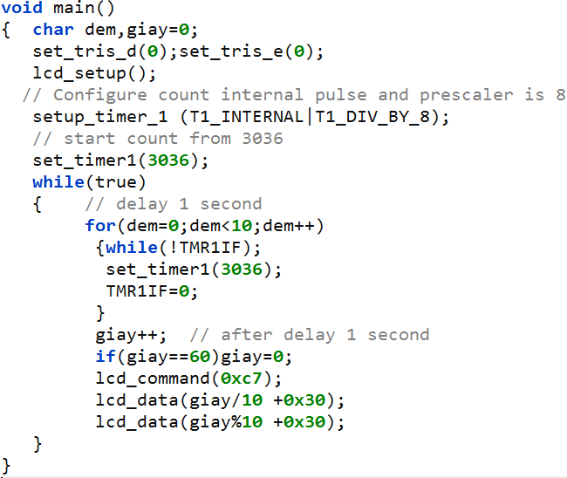
CODE

Slide 38
Test the theory by simulink

Slide 39
Thank You !

